Slide 1
OSPF
BSCI Module 3

Slide 2
Purpose of this Lesson
Coverage of topics new to the “OSPF” module of BSCI.
What’s new in this module?
  Some new terminology and acronyms
  More detailed explanation of LSAs and the Link-state Database
  Several new OSPF configuration and verification commands
  OSPF authentication configuration and verification commands
Notes:
The purpose of this lesson is to introduce you to new OSPF concepts and configurations that are now covered on the BSCI exam. We will discuss some new terminology and acronyms, look at Link State Advertisements and the Link-State Database in more detail, and review several new OSPF configuration and verification commands

Slide 3

New Terminology

Slide 4
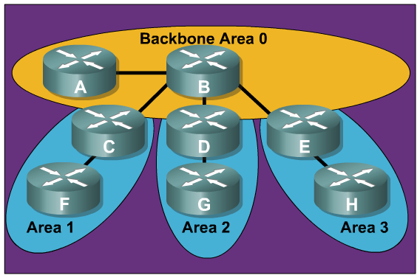
OSPF Areas
Review of OSPF area characteristics:
  Minimizes routing
  table entries
  Localizes impact of
  a topology change
  within an area
  Detailed LSA
  flooding stops at
  the area boundary
  Requires a
  hierarchical
  network design
Notes:
First, let’s start with a review of the characteristics of OSPF’s hierarchical design. Recall that OSPF allows for the creation of multiple areas so that the network administrator can:
Reduce the size of routing tables
Isolate topology changes as much as possible to the area in which they occur
Allow only summary LSA updates to cross area boundaries and
Reap all the benefits of using a hierarchical addressing scheme.

Slide 5

OSPF Areas
New terminology for areas:
  Transit Area
    Also known as Backbone Area 0
  Regular Area
    Also known as Nonbackbone areas
Notes:
You should be aware that the backbone area is also referred to as a transit area. This distinction is a minor one, but is enough to cause confusion for students. Another type of transit area is one that is configured with virtual links. Recall that virtual links are a temporary solution when an organization has two backbones that are physically and logically disconnected. A virtual link between the two backbones is also called a transit area.
All other areas are known as regular areas (standard areas, stub areas, totally stubby areas, and NSSAs)

Slide 6
OSPF Database
OSPF maintains three databases
Adjacency Database (show ip ospf neighbor)
Link-state Database (show ip ospf database)
Forwarding Database (show ip route)
Notes:
Remember that OSPF uses three databases in its operation:
The Adjacency Database is a table listing all OSPF neighbors with which the local router has established bidirectional communication. Display this table with the show ip ospf neighbor command.
The Link-state Database is a table listing all other routers in the network. This database shows the network topology. All OSPF routers in the same area have identical Link-state Databases. Display this table with the show ip ospf database command.
The Forwarding Database is simply the routing table. It includes a list of all routes generated when the SPF algorithm is calculated on the Link-state Database. Display this table with the show ip route command.

Slide 7
What is LSDB?
LSDB is an acronym for Link-state Database.
Notes:
You may not have seen the acronym, LSDB, in your studies or readings about OSPF. LSDB simply stands for Link-state Database.

Slide 8
LSAs and the Link-state Database

Slide 9
LSA Sequence Numbering
Each LSA in the LSDB maintains a sequence number.
The sequence numbering scheme is a 4-byte number that begins with 0x80000001 and ends with 0x7FFFFFFF.
OSPF floods each LSA every 30 minutes to maintain proper database synchronization. Each time the LSA is flooded, the sequence number is incremented by one.
Ultimately, an LSA sequence number will wrap around to 0x80000001. When this occurs, the existing LSA is prematurely aged to maxage (one hour) and flushed.
When a router encounters two instances of an LSA, it must determine which is more recent. The LSA having the newer (higher) LS sequence number is more recent.
Notes:
A combination of the maximum age (maxage) and refresh timers, as well as link-state sequence numbers, helps OSPF maintain a database of only the most recent link-state records.
The link-state sequence number field in an LSA header is 32 bits in length. (Remember that LSAs are Link State Advertisements sent in LSUs). Beginning with the left-most bit set, the first legal sequence number is 0x80000001. It is used to detect old or redundant LSAs; the larger the number, the more recent the LSA.
To ensure an accurate database, OSPF floods each LSA every 30 minutes. Each time a record is flooded, the sequence number is incremented by one. The local router will reset a LSA’s maximum age when it receives a new LSA update. An LSA will never remain longer in the database than the maximum age of one hour without a refresh.
It is possible for an LSA to remain in the database for long periods of time, being refreshed every 30 minutes. At some point, the sequence number will need to wrap back to the starting sequence number. When this process occurs, the existing LSA will be prematurely aged out (the maxage timer is immediately set to one hour) and flushed. The LSA will then begin its sequencing at 0x80000001 again.

Slide 10
The OSPF Link-State Database
The show ip ospf database command displays the current LSDB for the local router.
The next slide discusses the purpose of the Age and Seq# fields highlighted below.
RTC#show ip ospf database
OSPF Router with ID (192.168.1.253) (Process ID 3)
Router Link States (Area 0)
Link ID ADV Router Age Seq# Checksum Link count
192.168.1.249 192.168.1.249 1705 0x80000005 0x00D5B0 5
192.168.1.253 192.168.1.253 1578 0x80000006 0x009F91 5
Notes:
We are all familiar with the output of the show ip ospf database command. Shown here is some very abbreviated output.
Notice that each LSA entry has its own aging timer, which the link-state age field carries. The default timer value for OSPF is 30 minutes, which is expressed in seconds in the link-state age field.
After an LSA entry ages, the router that originated the entry sends the LSA, with a higher sequence number, in an LSU to verify that the link is still active. The LSU can contain one or more LSAs. This LSA validation method saves on bandwidth compared to distance vector routers, which send their entire routing table at short periodic intervals.

Slide 11

Link-State Data Structures: LSA Operation
Notes:
When each router receives the LSU, it does the following:
If the LSA does not already exist, the router adds the entry to its link-state database, sends a link-state acknowledgment (LSAck) back, floods the information to other routers, runs SPF, and updates its routing table.
If the entry already exists and the received LSA has the same sequence number, the router ignores the LSA entry.
If the entry already exists but the LSA includes newer information (it has a higher sequence number), the router adds the entry to its link-state database, sends an LSAck back, floods the information to other routers, runs SPF, and updates its routing table.
If the entry already exists but the LSA includes older information, it sends an LSU to the sender with its newer information.
It is important to note that each router will run SPF on a particular route every 30 minutes because the originating router for that route will refresh the LSA with a new sequence number every 30 minutes.

Slide 12
Verifying LSA Age and Sequence Number
In the first output below, notice the age timer will expire sometime after 1800 seconds or 30 minutes.
RTC#show ip ospf database
OSPF Router with ID (192.168.1.253) (Process ID 3)
Router Link States (Area 0)
Link ID ADV Router Age Seq# Checksum Link count
192.168.1.249 192.168.1.249 1705 0x80000005 0x00D5B0 5
192.168.1.253 192.168.1.253 1578 0x80000006 0x009F91 5
A few minutes later, the router has received an LSU for both links. Note the refreshed age timer and incremented sequence number.
RTC#show ip ospf database
OSPF Router with ID (192.168.1.253) (Process ID 3)
Router Link States (Area 0)
Link ID ADV Router Age Seq# Checksum Link count
192.168.1.249 192.168.1.249 106 0x80000006 0x00D3B1 5
192.168.1.253 192.168.1.253 58 0x80000007 0x009D92 5
Notes:
Here we see the same show ip ospf database output shown earlier. Notice that the age timer should expire soon since LSA entries have a 30 minute timer. A few minutes later, the show ip ospf database command verifies that, indeed, the age timer has been refreshed and the sequence number has been incremented.

Slide 13
Basic OSPF Configuration

Slide 14
Configuring OSPF
An excellent resource for information on the many different OSPF configurations is the Cisco white paper, “Configuring OSPF”, which can be downloaded from the Cisco website:
  http://www.cisco.com/en/US/products/sw/iosswrel/ps1835/products_configuration_guide_chapter09186a00800b3f2e.html
Notes:
Instructors should download

Slide 15
Configuring Basic OSPF
Router(config)#
router ospf process-id [vrf vpn-name]
Enable one or more OSPF routing processes.
Router(config-router)#
network ip-address wildcard-mask area area-id
Define the interfaces that OSPF will run on.
Router(config-if)#
ip ospf process-id area area-id [secondaries none]
Optional method to enable OSPF explicitly on an interface.
Notes:
We know that to configure the OSPF process, complete the following steps:
Step 1: Enable the OSPF process on the router using the router ospf command. The process-id is an internally used number to identify the OSPF routing process. The process ID does not need to match process IDs on other routers. Running multiple OSPF processes on the same router is not recommended because it creates multiple database instances that add extra overhead.
However, if you are routing for multiple VPN routing and forwarding instances, the each VRF needs its own routing process. The vrf vpn-name option specifies the name of the VPN routing and forwarding (VRF) instance to associate with OSPF VRF processes. For more information on configuring VRF and OSPF refer to the following Cisco link:
http://www.cisco.com/en/US/products/ps6350/products_configuration_guide_chapter09186a008045577b.html
Step 2: Identify which interfaces on the router are part of the OSPF process, using the
network command, as shown in the figure. We are all familiar with this command.
The ip ospf process-id area area-id interface command is a completely new command starting with Cisco IOS Release 12.3(11)T. With this command, you can enable OSPF directly on an interface, which simplifies the configuration of unnumbered interfaces. Because the command is configured explicitly for the interface, it will take precedence over the network area command. The secondaries none option will prevent secondary IP addresses on the interface from being advertised.

Slide 16
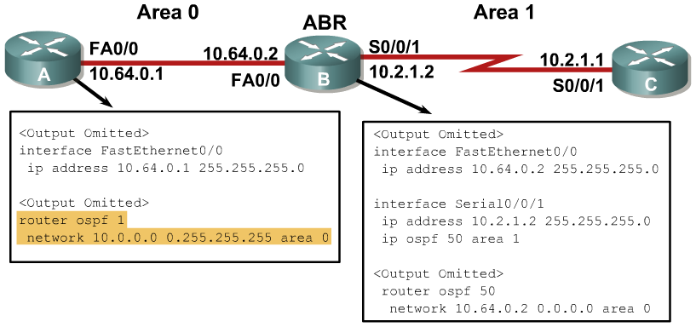
Configuring OSPF for Multiple Areas
Notes:
Example: Configuring OSPF for Multiple Areas
The figure shows an example of multiarea OSPF configuration. Router A is in area 0, router C is in area 1, and router B is the area border router (ABR) between the two areas.
The configuration for router A is nothing new. However although Router B has a network statement for area 0 within the OSPF routing process, notice that the configuration for area 1 uses the ip ospf 50 area 1 command on the interface. Alternatively, we could have used a separate network router configuration command in the OSPF routing process.

Slide 17
OSPF Router ID
The router is known to OSPF by the OSPF router ID number.
LSDBs use the OSPF router ID to differentiate one router from the next.
By default, the router ID is the highest IP address on an active interface at the moment of OSPF process startup.
  If no interface is up when the OSPF process starts, you will get the following error message:
  p5r2(config)#router ospf 1
  2w1d: %OSPF-4-NORTRID: OSPF process 1 cannot start.
A loopback interface can override the OSPF router ID. If a loopback interface exists, the router ID is the highest IP address on any active loopback interface.
The OSPF router-id command can be used to override the OSPF router ID.
Using a loopback interface or a router-id command is recommended for stability.
Notes:
The OSPF database uses the OSPF router ID to uniquely describe each router in the network. Remember that every router keeps a complete topology database of all routers and links in an area (or network); therefore each router should have a unique router ID.
As a review, remember that the router ID is a unique IP address that can be assigned in the following ways:
By default, the highest IP address of any active physical interface when OSPF starts is chosen as the router ID. The interface does not have to be part of the OSPF process, but it has to be up. There must be at least one up IP interface on the router for OSPF to use as router ID. If no up interface with an IP address is available when the OSPF process starts, the “OSPF process cannot start” message occurs
If there is a loopback interface, its address will always be preferred as the router ID instead of a physical interface address, because a loopback interface never goes down. If there is more than one loopback interface, then the highest IP address on any active loopback interface becomes the router ID.
Finally, you can use the router-id command to set the router ID. This is the preferred way to establish a router ID and should always used in preference to the other two procedures.
Once the OSPF router ID is set, it does not change, even if the interface that the router is using for the router ID goes down. The OSPF router ID changes only if the router reloads or if the OSPF routing process restarts.

Slide 18
OSPF router-id Command
Router(config-router)#
router-id ip-address
  This command is configured under the router ospf [process-id] command.
  Any unique arbitrary 32-bit value in an IP address format (dotted decimal) can be used.
  If this command is used on an OSPF process that is already active, then the new router ID takes effect after the next reload or after a manual restarting of the OSPF process using:
Router#clear ip ospf process
Router(config)#router ospf 1
Router(config-router)#router-id 172.16.1.1
Router#clear ip ospf process
Notes:
Use the OSPF router-id command to ensure that OSPF selects a specific router ID. The ip-address parameter can be any unique arbitrary 32-bit value in an IP address dotted decimal format.
After the router-id command is configured, use the clear ip ospf process command. This command restarts the OSPF routing process so that it will reselect the new IP address as its router ID.

Slide 19
NBMA OSPF Configuration

Slide 20
OSPF over NBMA Topology Modes of Operation
RFC 2328-compliant modes are as follows:
  Nonbroadcast (NBMA)
  Point-to-multipoint
Additional modes from Cisco are as follows:
  Point-to-multipoint nonbroadcast
  Broadcast
  Point-to-point
Router(config-if)#
ip ospf network [{broadcast | non-broadcast | point-to-multipoint [non-broadcast] | point-to-point}]
This interface command defines OSPF network type.
Notes:
The ip ospf network interface command has several options. Each option applies to a different NBMA OSPF mode. Your students should be comfortable configuring OSPF over NBMA using the two RFC-compliant modes (non-broadcast and point-to-multipoint) and the three Cisco modes (broadcast, point-to-multipoint non-broadcast, and point-to-point)
Over the next couple of slides, we will detail the OSPF configurations for the five NBMA modes.

Slide 21
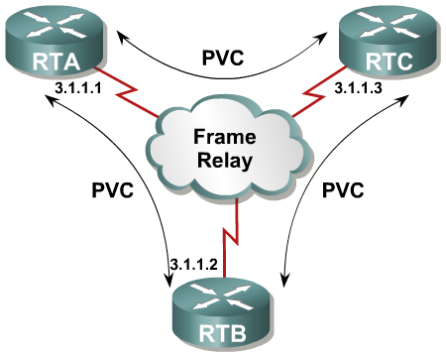
RFC-compliant Non-broadcast Mode
One IP subnet.
Neighbors must be manually configured.
DR and BDR elected.
DR and BDR need to have full connectivity with all other routers.
Typically used in a full mesh topology.
RTB(config-if)#ip ospf network non-broadcast
--------
RTB(config-router)#network 3.1.1.0 0.0.0.255 area 0
RTB(config-router)#neighbor 3.1.1.1
RTB(config-router)#neighbor 3.1.1.3
Notes:
The non-broadcast argument is used for NBMA topologies that have the following characteristics:
One IP subnet.
Neighbors must be manually configured.
DR and BDR elected.
DR and BDR need to have full connectivity with all other routers.
Typically used in a full-mesh topology.

Slide 22

RFC-compliant Point-to-Multipoint Mode
One IP subnet.
Uses multicast OSPF hello packet to automatically discover neighbors.
DR and BDR not required
Typically used in a partial-mesh or hub-and-spoke topology.
RTB(config-if)#ip ospf network point-to-multipoint
--------
RTB(config-router)#network 3.1.1.0 0.0.0.255 area 0
Notes:
When using the point-to-multipoint broadcast mode, there is no need to configure neighbors since they will be dynamically discovered. The point-to-multipoint argument is used for NBMA topologies that have the following characteristics:
One IP subnet.
Uses multicast OSPF hello packet to automatically discover the neighbors.
DR and BDR not required—router sends additional LSAs with more information about neighboring routers.
Typically used in partial-mesh or star topology.

Slide 23
Cisco’s Point-to-Multipoint Non-broadcast mode
Cisco extension to RFC-compliant point-to-multipoint mode
Must statically define neighbors, like nonbroadcast mode
Like point-to-multipoint mode, DR/BDR not elected
Used in special cases where neighbors
cannot be automatically discovered
RTB(config-if)#ip ospf network point-to-multipoint non-broadcast
--------
RTB(config-router)#network 3.1.1.0 0.0.0.255 area 0
RTB(config-router)#neighbor 3.1.1.1 cost 10
RTB(config-router)#neighbor 3.1.1.3 cost 20
Notes:
The point-to-multipoint non-broadcast mode is a Cisco extension of the RFC-compliant point-to-multipoint mode and is used when the media does not support broadcast (such as classic IP over ATM: see “Configuring OSPF” white paper). You must statically define neighbors, and you can modify the cost of the link to the neighboring router to reflect the different bandwidths of each link. The RFC point-to-multipoint mode was developed to support underlying point-to-multipoint VCs that support multicast and broadcast; therefore, this mode allows dynamic neighboring router discovery. If multicast and broadcast are not enabled on the VCs, the RFC-compliant point-to-multipoint mode cannot be used because the router cannot dynamically discover its neighboring routers using the hello multicast packets; this Cisco mode should be used instead.
Also, it is a good idea to configure the neighbor cost. Otherwise, the local router will assume equal cost to the configured neighbors. In the example, RTA is configured as a neighbor with a cost of 10 and RTC is configured as a neighbor with a cost of 20. These cost values are purely arbitrary and are only meant for demonstration purposes. You would, of course, configure an accurate cost value in a live network configuration.

Slide 24
Cisco’s Broadcast Mode
Makes a WAN interface appear to be a LAN
One IP subnet
Uses multicast hellos to discover neighbors
DR and BDR elected
Requires a full mesh.
RTB(config-if)#ip ospf network broadcast
--------
RTB(config-router)#network 3.1.1.0 0.0.0.255 area 0
Notes:
The Cisco broadcast mode is a workaround so that you don’t have to statically listing all existing neighbors. The interface is set to broadcast and behaves as though the router connects to a LAN. DR and BDR election is still performed; therefore, take special care to ensure either a full-mesh topology or a static election of the DR based on the interface priority.
This mode has the following characteristics:
Makes the WAN interface appear to be a LAN.
One IP subnet.
Uses multicast OSPF hello packet to automatically discover the neighbors.
DR and BDR elected.
Requires a full-mesh topology.

Slide 25

Cisco’s Point-to-Point mode
One IP subnet per subinterface pair
No DR or BDR election
Used when only two routers need to form an adjacency on a pair of interfaces
Same properties as any physical point-to-point physical interface
RTB(config)#interface serial 0/0.1
RTB(config-subif)#ip address 3.1.1.2 255.255.255.0
RTB(config-subif)#interface serial 0/0.2
RTB(config-subif)#ip address 4.1.1.2 255.255.255.0
--------
RTB(config-router)#network 3.1.1.0 0.0.0.255 area 0
RTB(config-router)#network 4.1.1.0 0.0.0.255 area 0
Notes:
As we already know, a physical interface can be split into multiple logical interfaces, called subinterfaces. Each subinterface is defined as a point-to-point or a point-to-multipoint interface. Subinterfaces were originally created to better handle issues caused by split horizon over an NBMA for distance vector-based routing protocols. Each subinterface requires an IP subnet. There is no need to use the ip ospf network command since IOS treats these interfaces like physical point-to-point interfaces.
This mode can also be used in a hub-and-spoke topology and includes that following characteristics:
One IP subnet.
No DR or BDR election.
Used when only two routers need to form an adjacency on a pair of interfaces.
Interfaces can be either LAN or WAN.

Slide 26
Using the neighbor Command
Router(config-router)#
neighbor ip-address [priority number] [poll-interval number] [cost number] [database-filter all]
Used to statically define neighbor relationships in an NBMA network
Notes:
As we just discussed, the neighbor command must be configured in both non-broadcast modes: the RFC-complaint non-broadcast mode and Cisco’s point-to-multipoint non-broadcast mode.
In the current version of the curriculum, the neighbor command is only briefly discussed. Students should know how to configure the neighbor command and be aware of all the options shown in the slide.
The OSPF neighbor command is used to statically define adjacent relationships in NBMA networks using the nonbroadcast mode.

Slide 27
The neighbor command options
Router(config-router)#
neighbor ip-address [priority number] [poll-interval number] [cost number] [database-filter all]
Option | Description
priority number | Specifies the priority of neighbor. Default is zero, which means neighbor can never be DR.
poll-interval number | Amount of time a NBMA interface waits before sending hellos to the neighbor even if the neighbor is inactive.
cost number | Assigns a cost to the neighbor from 1 to 65535. Neighbors with no specific cost configured will assume the cost of the interface, based on the ip ospf cost command. (Not used with NBMA)
database-filter all | Filters outgoing LSAs to an OSPF neighbor
Notes:
Here we have what each of the options is used for.
Priority number is a way to ensure that the local router knows what the neighbor’s priority is for DR/BDR elections.
Poll-interval is a way to set the hello interval on a neighbor by neighbor basis.
Cost is used when multiple neighbors have different costs. This is important when configuring point-to-multipoint mode, as we saw early.
Database-filter stops all LSAs from being sent to this neighbor, which is important in point-to-multipoint networks where too much LSA redundancy can waste bandwidth.

Slide 28
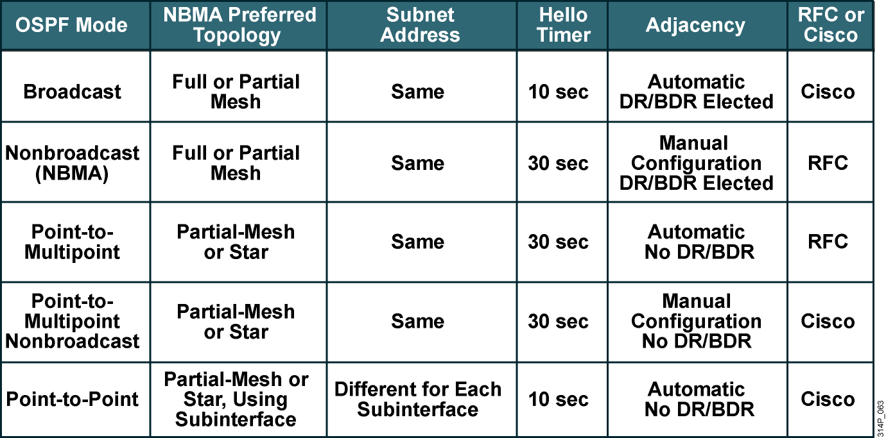
OSPF over NBMA Topology Summary
Notes:
This slide provides a concise comparison of the various modes of operation for OSPF over NBMA topologies.

Slide 29
Virtual Link Concepts and Configuration

Slide 30
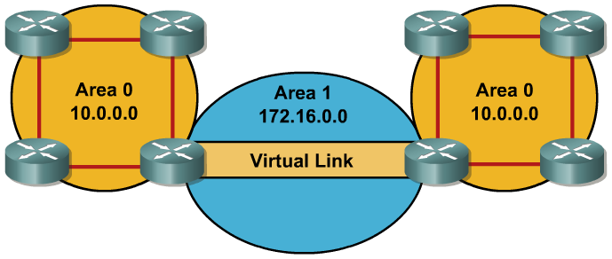
Virtual Links
Virtual links are used to connect a discontiguous area to area 0.
A logical connection is built between router A and router B.
Virtual links are recommended for backup or temporary connections.
Notes:
The current curriculum covers the concept and configuration of virtual links. Remember that virtual links are meant to solve a temporary discontinuity problem in the backbone. They are not meant as a permanent solution.

Slide 31
Special Treatment for LSAs on Virtual Links
LSAs usually age out after 30 minutes
LSAs learned across virtual links have the DoNotAge (DNA) option set
Required to prevent excessive flooding over virtual links
Notes:
(New information here includes the following: LSAs learned through a virtual link have the DoNotAge (DNA) option set, so that the LSA does not age out. This DNA technique is required to prevent excessive flooding over the virtual link. Also covers details of the options to the area virtual-link command; Explains the output of the show ip ospf virtual-links command which is only used in a current lab, but not explained.)
New to the version of the BSCI exam is understanding how LSAs work across virtual links. The Hello protocol works over virtual links as it does over standard links, in 10-second intervals. However, LSA updates work differently on virtual links. An LSA usually refreshes every 30 minutes; LSAs learned through a virtual link have the DoNotAge (DNA) option set, so that the LSA does not age out. This DNA technique is required to prevent excessive flooding over the virtual link.

Slide 32
Configuring Virtual Links
Router(config-router)#
area area-id virtual-link router-id [authentication [message-digest | null]] [hello-interval seconds] [retransmit-interval seconds] [transmit-delay seconds] [dead-interval seconds] [[authentication-key key] | [message-digest-key key-id md5 key]]
Creates a virtual link
Optional parameters are used in place of interface ip ospf commands
Notes:
We are already familiar with how to configure a basic virtual link. Simply use the area area-id virtual-link router-id router configuration command on each side of the link to define an OSPF virtual link. However, notice all the optional parameters that we can configure for the virtual link. If necessary for the virtual link, authentication and timing intervals must be configured here because the link is virtual. The equivalent ip ospf commands on the physical interface will not apply to traffic on the virtual link.

Slide 33
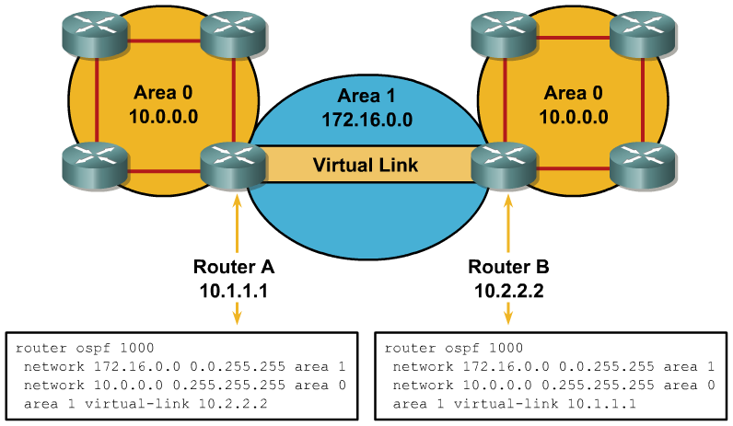
Configuring and Verifying a Virtual Link
RouterA#sh ip ospf virtual-links
Virtual Link OSPF_VL0 to router 10.2.2.2 is up
Run as demand circuit
DoNotAge LSA allowed.
Transit area 1, via interface Serial0/0/1, Cost of using 781
Transmit Delay is 1 sec, State POINT_TO_POINT,
Timer intervals configured, Hello 10, Dead 40, Wait 40, Retransmit 5
Hello due in 00:00:07
Adjacency State FULL (Hello suppressed)
Index 1/2, retransmission queue length 0, number of retransmission 1
First 0x0(0)/0x0(0) Next 0x0(0)/0x0(0)
Last retransmission scan length is 1, maximum is 1
Last retransmission scan time is 0 msec, maximum is 0 msec
Notes:
In the figure, area 0 is discontiguous because of a network failure. A virtual link is used as a backup strategy to temporarily reconnect area 0; area 1 is used as the transit area.
Router A builds a virtual link to router B, and router B builds a virtual link to the router A. Each router points at the other’s router ID.
Use the show ip ospf virtual-links command to verify that the configured virtual link works properly.

Slide 34
LSA Types

Slide 35
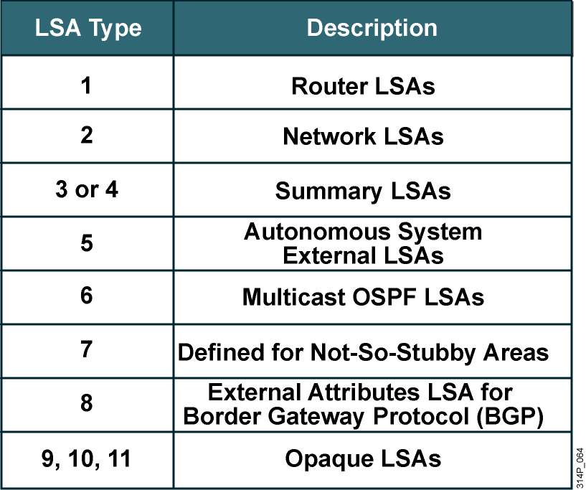
LSA Types
Notes:
This slide shows a quick overview of each of the LSA types.

Slide 36
The Link ID in the OSPF Database
RouterA#show ip ospf database
OSPF Router with ID (10.0.0.11) (Process ID 1)
Router Link States (Area 0)
Link ID ADV Router Age Seq# Checksum Link count
10.0.0.11 10.0.0.11 548 0x80000002 0x00401A 1
10.0.0.12 10.0.0.12 549 0x80000004 0x003A1B 1
100.100.100.100 100.100.100.100 548 0x800002D7 0x00EEA9 2
Net Link States (Area 0)
Link ID ADV Router Age Seq# Checksum
172.31.1.3 100.100.100.100 549 0x80000001 0x004EC9
Summary Net Link States (Area 0)
Link ID ADV Router Age Seq# Checksum
10.1.0.0 10.0.0.11 654 0x80000001 0x00FB11
10.1.0.0 10.0.0.12 601 0x80000001 0x00F516
<output omitted>
Notes:
We will briefly review each LSA type and focus on the Link-state ID of each LSA Type. The Link-state ID can be seen in the Link-state Database as highlighted here.

Slide 37

LSA Type 1: Router LSA
One router LSA (type 1) for every router in an area:
  Includes list of directly attached links
Identified by the router ID of the originating router
Floods within its area only; does not cross ABR
Link-state ID depends on link type
Notes:
A router advertises a type 1 LSA that floods to all other routers in the area in which it originated. Remember that a type 1 LSA describes the collective states of the directly connected links (interfaces) of the router.

Slide 38
LSA Type 1 Link Types
Link Type | Description | Link-state ID
1 | Point-to-point connection to another router | Neighboring router ID
2 | Connection to a transit network | IP address of DR
3 | Connection to a stub network | IP network/subnet number
4 | Virtual link | Neighboring router ID
Notes:
Each router link in a Type 1 LSA is defined as one of four types: types 1, 2, 3, or 4. The LSA includes a link ID field that identifies, by the network number and mask, the object this link connects to.
LSA Type 1 Link Types
Depending on the type, the link ID has different meanings, as described in the table.
Link Type Description Link-state ID
1 Point-to-point to another router Neighboring router ID
2 Connection to a transit network IP address of DR
3 Connection to a stub network IP network/subnet number
4 Virtual link Neighboring router ID
A stub network is a dead-end link that has only one router attached.
In addition, the type 1 LSA describes whether the router is an ABR or ASBR.

Slide 39

LSA Type 2: Network LSA
Advertised by the DR of the broadcast network
Floods within its area only; does not cross ABR
Link-state ID is the DR
Notes:
The DR of the network is responsible for advertising the Type 2 network LSA. A type 2 network LSA lists each of the attached routers that make up the area, including the DR itself, as well as the subnet mask used on the link. The type 2 LSA then floods to all routers within the network area. Type 2 LSAs never cross an area boundary. The link ID for a network LSA is the IP interface address of the DR that advertises it.

Slide 40

LSA Type 3: Summary LSA
Advertised by the ABR of originating area.
Regenerated by subsequent ABRs to flood throughout the autonomous system.
By default, routes are not summarized, and type 3 LSA is advertised for every subnet.
Link-state ID is the network or subnet advertised in the summary LSA
Notes:
The ABR sends type 3 summary LSAs. Type 3 LSAs advertise any networks owned by an area to the rest of the areas in the OSPF AS, as shown here.
The link-state ID is set to the network number; the mask is also advertised. Remember that Summary LSAs do not, by default, summarize routes. This must be manually configured. So each Type 3 LSA has the link ID set to the network (subnet) that it is advertising.

Slide 41

LSA Type 4: Summary LSA
Summary (type 4) LSAs are used to advertise an ASBR to all other areas in the autonomous system.
They are generated by the ABR of the originating area.
They are regenerated by all subsequent ABRs to flood throughout the autonomous system.
Link-state ID is the router ID of the ASBR.
Notes:
A type 4 summary LSA is generated by an ABR only when an ASBR exists within an area. Therefore, the link ID is set to the ASBR router ID.

Slide 42

LSA Type 5: External LSA
External (type 5) LSAs are used to advertise networks from other autonomous systems.
Type 5 LSAs are advertised and owned by the originating ASBR.
The Link-state ID is the external network number.
Notes:
Type 5 external LSAs describe routes to networks outside the OSPF AS. Type 5 LSAs are originated by the ASBR and are flooded to the entire AS. The link ID is the external network number.

Slide 43
Interpreting the OSPF Database
RouterA#show ip ospf database
OSPF Router with ID (10.0.0.11) (Process ID 1)
Router Link States (Area 0)
Link ID ADV Router Age Seq# Checksum Link count
10.0.0.11 10.0.0.11 548 0x80000002 0x00401A 1
10.0.0.12 10.0.0.12 549 0x80000004 0x003A1B 1
100.100.100.100 100.100.100.100 548 0x800002D7 0x00EEA9 2
Net Link States (Area 0)
Link ID ADV Router Age Seq# Checksum
172.31.1.3 100.100.100.100 549 0x80000001 0x004EC9
Summary Net Link States (Area 0)
Link ID ADV Router Age Seq# Checksum
10.1.0.0 10.0.0.11 654 0x80000001 0x00FB11
10.1.0.0 10.0.0.12 601 0x80000001 0x00F516
<output omitted>
Notes:
The figure illustrates use of the show ip ospf database command to get information about an OSPF LSDB. The router link states are type 1 LSAs, the net link states are type 2 LSAs, and the summary net link states are type 3 LSAs.
The database columns are as follows:
Link ID: Identifies each LSA.
ADV router: Advertising router; the source router of the LSA.
Age: The maximum age counter in seconds; the maximum age is 1 hour or 3,600 seconds.
Seq#: Sequence number of the LSA; this number begins at 0x80000001 and increases with each update of the LSA.
Checksum: Checksum of the individual LSA to ensure reliable receipt of that LSA.
Link count: Total number of directly attached links, used only on router LSAs. The link count includes all point-to-point, transit, and stub links. Each point-to-point serial link counts as two; all other links count as one, including Ethernet links.

Slide 44
LSDB Overload Protection

Slide 45
OSPF LSDB Overload Protection
Router(config-router)#
max-lsa maximum-number [threshold-percentage] [warning-only] [ignore-time minutes] [ignore-count count-number] [reset-time minutes]
Excessive LSAs generated by other routers can drain local router resources.
This feature can limit the processing of non-self-generated LSAs for a defined OSPF process.
Notes:
OSPF LSDB Overload Protection is an all new objective.
If other routers are misconfigured, causing, for example, a redistribution of a large number of prefixes, large numbers of LSAs can be generated. These excessive LSAs can drain local CPU and memory resources. OSPF LSDB overload protection can be configured to protect against this issue by using the max-lsa command in router configuration mode.

Slide 46
The max-lsa Parameters
Router(config-router)#
max-lsa maximum-number [threshold-percentage] [warning-only] [ignore-time minutes] [ignore-count count-number] [reset-time minutes]
Parameter | Description
maximum-number | Maximum number of non-self-generated LSAs that the OSPF process can keep in the OSPF LSBD.
threshold-percentage | (Optional) The percentage of the maximum LSA number, as specified by the maximum-number argument, at which a warning message is logged. The default is 75 percent.
warning-only | (Optional) Specifies that only a warning message is sent when the maximum limit for LSAs is exceeded; the OSPF process never enters ignore state. Disabled by default.
ignore-time minutes | (Optional) Specifies the time to ignore all neighbors after the maximum limit of LSAs has been exceeded. The default is 5 minutes.
ignore-count count-number | (Optional) Specifies the number of times that the OSPF process can consecutively be placed into the ignore state. The default is five times.
reset-time minutes | (Optional) Specifies the time, in minutes, after which the ignore count is reset to 0. The default is 10 minutes.
Notes:
Here we see a description of all the options that can be configured for with the max-lsa command.
When this feature is enabled, the router keeps count of the number of received (non-self-generated) LSAs that it keeps in its LSDB. An error message is logged when this number reaches a configured threshold number, and a notification is sent when it exceeds the threshold number, which is, by default, 75% of the max-lsa number configured.
If the LSA count still exceeds the threshold after one minute, the OSPF process takes down all adjacencies and clears the OSPF database; this is called the ignore state. In this ignore state, no OSPF packets are sent or received by interfaces that belong to that OSPF process.
The OSPF process remains in ignore state for the time that is defined by the ignore-time parameter. The ignore-count parameter defines the maximum number of times that the OSPF process can consecutively enter the ignore state before remaining permanently down and requiring manual intervention.
If the OSPF process remains normal for the time that is defined by the reset-time parameter, the ignore state counter is reset to 0.
FMI: http://www.cisco.com/univercd/cc/td/doc/product/software/ios120/120newft/120limit/120s/120s27/ospfopro.htm

Slide 47
Changing Cost

Slide 48
Changing the Cost Metric
The cost, or metric, is an indication of the overhead to send packets over an interface. Default = (100 Mbps)/(bandwidth in Mbps).
RouterA(config-router)#
auto-cost reference-bandwidth ref-bw
Sets the reference bandwidth to values other than 100 Mbps (legal values range from 1 to 4,294,967 in Mbps).
RouterA(config-if)#
ip ospf cost interface-cost
Overrides the default cost calculation. Values from 1 to 65535 can be defined.
Notes:
(the auto-cost reference-bandwidth command is new)
Remember that IOS calculates the OSPF metric for an interface according to the inverse bandwidth of the interface. In general, the cost in Cisco routers is calculated using the formula (100 Mbps)/(bandwidth in Mbps). This means that the maximum bandwidth is 100 Mbps, which is a cost of 1. If you have faster interfaces, you may want to recalibrate the cost of 1 to a higher bandwidth.
If interfaces that are faster than 100 Mbps are being used, you should use the auto-cost reference-bandwidth ref-bw command on all routers in the network to ensure accurate route calculations. The ref-bw is a reference bandwidth in Mbps, and ranges from 1 to 4,294,967.
If configured, the ip ospf cost interface-cost command will override the auto-cost reference-bandwidth command. The cost value is an integer from 1 to 65,535. The lower the number, the better and more strongly preferred the link.

Slide 49
Propagating Default Routes in NSSAs

Slide 50
NSSA Configuration
RouterA(config-router)#
area area-id nssa [no-redistribution] [default-information-originate [metric metric-value] [metric-type type-value]] [no-summary]
Use this command instead of the area stub command to define the area as NSSA.
no-summary creates an NSSA totally stubby area; this is a Cisco proprietary feature.
Notes:
As a review, to configure an area as an NSSA, complete the following steps:
1. Configure OSPF.
2. Define the area as NSSA by issuing the area area-id nssa command to all routers within the area. The area area-id nssa command is used in place of the area area-id stub command. Remember that all routers in the NSSA must have this command configured; routers will not form an adjacency unless both are configured as NSSA.

Slide 51
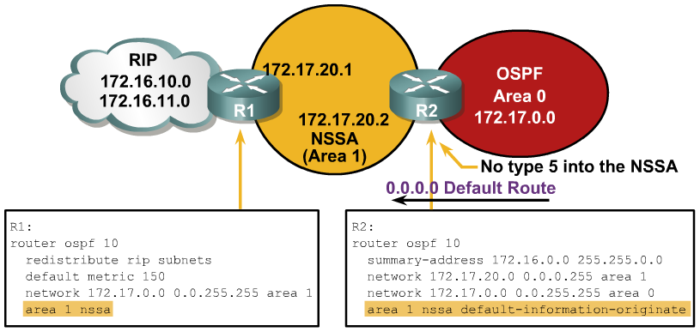
Example: NSSA Configuration
Notes:
In this NSSA configuration example, router 1 is the ASBR that is redistributing Routing Information Protocol (RIP) routes into area 1, the NSSA. Router 2 is the NSSA ABR. This router converts LSA type 7 into type 5 for advertisement into the backbone area 0. Router 2 is also configured to summarize the type 5 LSAs that originate from the RIP network: the 172.16.0.0 subnets will be summarized to 172.16.0.0/16 and advertised into area 0.
To cause router 2 (the NSSA ABR) to generate an O*N2 default route (O*N2 0.0.0.0/0) into the NSSA, use the default-information-originate option on the area 1 nssa command on router 2.

Slide 52

OSPF Authentication

Slide 53
OSPF Authentication Types
  OSPF supports 2 types of authentication:
    Simple password authentication (plain text)
    MD5 authentication
  Router generates and checks each packet and authenticates the source of each update packet it receives
  Configure a “key” (password)
    Note: all participating neighbors must have the same key configured
Notes:
Authentication types:
simple password authentication (plain text) and MD5 authentication
Recall that when neighbor authentication has been configured on a router, the router authenticates the source of each routing update packet that it receives. This is accomplished by the exchange of an authenticating key (sometimes referred to as a password) that is known to both the sending and the receiving router.
By default, OSPF uses null authentication, which means that routing exchanges over a network are not authenticated.

Slide 54
Configuring Simple Password Authentication
Router(config-if)#
ip ospf authentication-key password
Assign a password to be used with neighboring routers.
Router(config-if)#
ip ospf authentication [message-digest | null]
Specifies the authentication type for an interface (since IOS 12.0).
Router(config-router)#
area area-id authentication [message-digest]
Specifies the authentication type for an area (was in IOS before 12.0).
Notes:
Steps to configure OSPF simple password authentication:
Assign a password to be used with neighboring routers that are using the OSPF simple password authentication using the ip ospf authentication-key command, as shown in the figure.
The password created by this command is used as a “key” that is inserted directly into the OSPF header when the Cisco IOS software originates routing protocol packets. A separate password can be assigned to each network on a per-interface basis. All neighboring routers on the same network must have the same password to be able to exchange OSPF information.
Specify the authentication type using the ip ospf authentication command as shown in the figure.
For simple password authentication, use the ip ospf authentication command with no parameters. Before using this command, configure a password for the interface using the ip ospf authentication-key command.
The ip ospf authentication command was introduced in Cisco IOS Software Release 12.0. For backward compatibility, authentication type for an area is still supported. If the authentication type is not specified for an interface, the authentication type for the area will be used (the area default is null authentication). To enable authentication for an OSPF area, use the area area-id authentication [message-digest] router configuration command.
2.

Slide 55
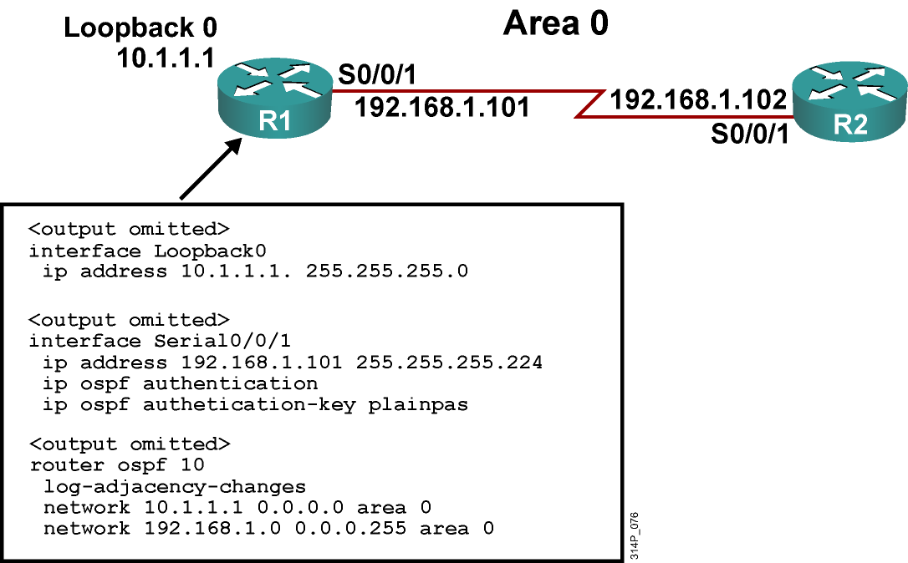
Example Simple Password Authentication Configuration
Notes:
The figure shows the network used to illustrate the configuration, verification, and troubleshooting of simple password authentication in the next few slides. The configuration of the R1 router is shown in this figure as well.
Simple password authentication is configured on interface serial 0/0/1 with the ip ospf authentication command. The interface is configured with an authentication key of plainpas.

Slide 56
R2 Configuration for Simple Password Authentication
<output omitted>
interface Loopback0
ip address 10.2.2.2 255.255.255.0
<output omitted>
interface Serial0/0/1
ip address 192.168.1.102 255.255.255.224
ip ospf authentication
ip ospf authentication-key plainpas
<output omitted>
router ospf 10
log-adjacency-changes
network 10.2.2.2 0.0.0.0 area 0
network 192.168.1.0 0.0.0.255 area 0
Notes:
Simple password authentication is configured on interface serial 0/0/1 with the ip ospf authentication command. The interface is configured with an authentication key of plainpas. Notice that the connecting interfaces on both R1 and R2 are configured for the same type of authentication with the same authentication key.

Slide 57
Verifying Simple Password Authentication
R1#sh ip ospf neighbor
Neighbor ID Pri State Dead Time Address Interface
10.2.2.2 0 FULL/ - 00:00:32 192.168.1.102 Serial0/0/1
R1#show ip route
<output omitted>
Gateway of last resort is not set
10.0.0.0/8 is variably subnetted, 2 subnets, 2 masks
O 10.2.2.2/32 [110/782] via 192.168.1.102, 00:01:17, Serial0/0/1
C 10.1.1.0/24 is directly connected, Loopback0
192.168.1.0/27 is subnetted, 1 subnets
C 192.168.1.96 is directly connected, Serial0/0/1
R1#ping 10.2.2.2
Type escape sequence to abort.
Sending 5, 100-byte ICMP Echos to 10.2.2.2, timeout is 2 seconds:
!!!!!
Success rate is 100 percent (5/5), round-trip min/avg/max = 28/29/32 ms
Notes:
The figure shows the output of the show ip ospf neighbor and show ip route commands.
The neighbor state is FULL, indicating that the two routers have successfully formed an OSPF adjacency. The routing table verifies that the 10.2.2.2 address has been learned via OSPF over the serial connection.
The results of a ping to the R2 loopback interface address is also displayed to illustrate that the link is working.

Slide 58
Configuring OSPF MD5 Authentication
Router(config-if)#
ip ospf message-digest-key key-id md5 key
Assign a key ID and key to be used with neighboring routers.
Router(config-if)#
ip ospf authentication [message-digest | null]
Specifies the authentication type for an interface (since IOS 12.0).
Router(config-router)#
area area-id authentication [message-digest]
Specifies the authentication type for an area (was in IOS before 12.0).
Notes:
MD5 authentication involved a 2-step process. To configure OSPF MD5 authentication, complete the following steps:
Assign a key ID and key to be used with neighboring routers that are using the OSPF MD5 authentication, using the ip ospf message-digest-key command, as shown in the figure.
The key and the key-id specified in this command are used to generate a message digest (also called a hash) of each OSPF packet; the message digest is appended to the packet. A separate password can be assigned to each network on a per-interface basis. The key-id allows for uninterrupted transitions between keys, which is helpful for administrators who wish to change the OSPF password without disrupting communication.
The router will stop sending duplicate packets once it detects that all of its neighbors have adopted the new key.
The process of changing keys is as follows. Suppose the current configuration is as follows:
interface FastEthernet 0/0
ip ospf message-digest-key 100 md5 OLD
Change the configuration to the following:
interface FastEthernet 0/0
ip ospf message-digest-key 101 md5 NEW
The system assumes its neighbors do not have the new key yet, so it begins a rollover process. Rollover allows neighboring routers to continue communication while the network administrator is updating them with the new key. Rollover stops once the local system finds that all its neighbors know the new key. The system detects that a neighbor has the new key when it receives packets from the neighbor authenticated by the new key.
Cisco recommends that you not keep more than one key per interface. Every time you add a new key, you should remove the old key to prevent the local system from continuing to communicate with a hostile system that knows the old key.
Specify the authentication type using the ip ospf authentication command as shown in the figure. The parameters for this command are as described in the previous topic. For MD5 authentication, use the ip ospf authentication command with the message-digest parameter. Before using this command, configure the message digest key for the interface with the ip ospf message-digest-key command.
Recall that the ip ospf authentication command was introduced in Cisco IOS Software Release 12.0. As it is for simple password authentication, the MD5 authentication type for an area is still supported using the area area-id authentication message-digest router configuration command, for backward compatibility.
NOTE: Limit to interfaces where attacks are possible

Slide 59
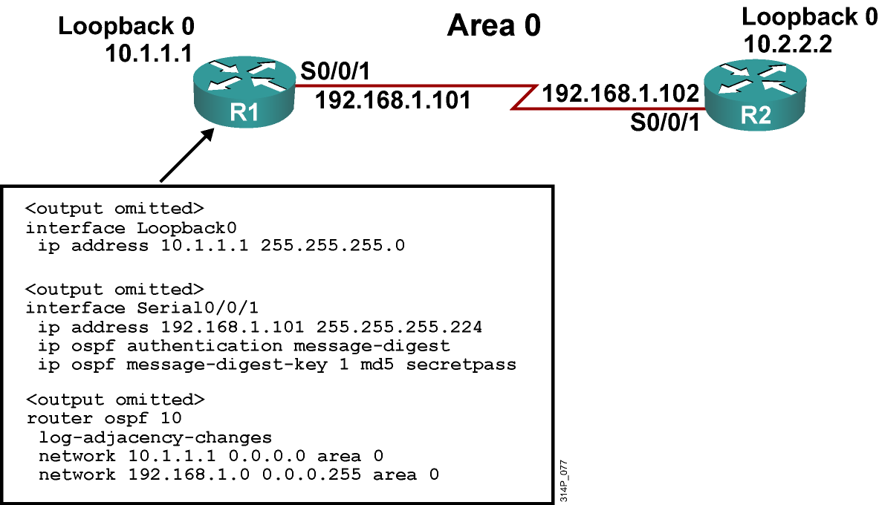
Example MD5 Authentication Configuration
Notes:
MD5 authentication is configured on interface serial 0/0/1 with the ip ospf authentication message-digest command. The interface is configured with an authentication key number 1 set to secretpass.

Slide 60
R2 Configuration for MD5 Authenticaiton
<output omitted>
interface Loopback0
ip address 10.2.2.2 255.255.255.0
<output omitted>
interface Serial0/0/1
ip address 192.168.1.102 255.255.255.224
ip ospf authentication message-digest
ip ospf message-digest-key 1 md5 secretpass
<output omitted>
router ospf 10
log-adjacency-changes
network 10.2.2.2 0.0.0.0 area 0
network 192.168.1.0 0.0.0.255 area 0
Notes:
MD5 authentication is configured on interface serial 0/0/1 with the ip ospf authentication message-digest command. The interface is configured with an authentication key number 1 set to secretpass. Notice that the connecting interfaces on both R1 and R2 are configured for the same type of authentication with the same authentication key and key-id.

Slide 61
Verifying MD5 Authentication
R1#sho ip ospf neighbor
Neighbor ID Pri State Dead Time Address Interface
10.2.2.2 0 FULL/ - 00:00:31 192.168.1.102 Serial0/0/1
R1#show ip route
<output omitted>
Gateway of last resort is not set
10.0.0.0/8 is variably subnetted, 2 subnets, 2 masks
O 10.2.2.2/32 [110/782] via 192.168.1.102, 00:00:37, Serial0/0/1
C 10.1.1.0/24 is directly connected, Loopback0
192.168.1.0/27 is subnetted, 1 subnets
C 192.168.1.96 is directly connected, Serial0/0/1
R1#ping 10.2.2.2
Type escape sequence to abort.
Sending 5, 100-byte ICMP Echos to 10.2.2.2, timeout is 2 seconds:
!!!!!
Success rate is 100 percent (5/5), round-trip min/avg/max = 28/28/32 ms
Notes:
The figure shows the output of the show ip ospf neighbor and show ip route commands.
Notice that the neighbor state is FULL, indicating that the two routers have successfully formed an OSPF adjacency. The routing table verifies that the 10.2.2.2 address has been learned via OSPF over the serial connection.
The results of a ping to the R2 loopback interface address is also displayed to illustrate that the link is working.

Slide 62
Troubleshooting Simple Password Authentication
Router#
debug ip ospf adj
Displays the OSPF adjacency-related events.
R1#debug ip ospf adj
OSPF adjacency events debugging is on
R1#
<output omitted>
*Feb 17 18:42:01.250: OSPF: 2 Way Communication to 10.2.2.2 on Serial0/0/1, state 2WAY
*Feb 17 18:42:01.250: OSPF: Send DBD to 10.2.2.2 on Serial0/0/1 seq 0x9B6 opt 0x52 flag 0x7 len 32
*Feb 17 18:42:01.262: OSPF: Rcv DBD from 10.2.2.2 on Serial0/0/1 seq 0x23ED opt0x52 flag 0x7 len 32 mtu 1500 state EXSTART
*Feb 17 18:42:01.262: OSPF: NBR Negotiation Done. We are the SLAVE
*Feb 17 18:42:01.262: OSPF: Send DBD to 10.2.2.2 on Serial0/0/1 seq 0x23ED opt 0x52 flag 0x2 len 72
<output omitted>
R1#show ip ospf neighbor
Neighbor ID Pri State Dead Time Address Interface
10.2.2.2 0 FULL/ - 00:00:34 192.168.1.102 Serial0/0/1
Notes:
The debug ip ospf adj command is used to display OSPF adjacency-related events and is very useful when troubleshooting authentication. This displays a successful connection.
The output of the show ip ospf neighbor command shown in the figure illustrates that R1 has successfully formed an adjacency with the R2.

Slide 63
Troubleshooting Simple Password Authentication Problems
Simple authentication on R1, no authentication on R2:
R1#
*Feb 17 18:51:31.242: OSPF: Rcv pkt from 192.168.1.102, Serial0/0/1 : Mismatch Authentication type. Input packet specified type 0, we use type 1
R2#
*Feb 17 18:50:43.046: OSPF: Rcv pkt from 192.168.1.101, Serial0/0/1 : Mismatch Authentication type. Input packet specified type 1, we use type 0
Simple authentication on R1 and R2, but different
passwords:
R1#
*Feb 17 18:54:01.238: OSPF: Rcv pkt from 192.168.1.102, Serial0/0/1 : Mismatch Authentication Key - Clear Text
R2#
*Feb 17 18:53:13.050: OSPF: Rcv pkt from 192.168.1.101, Serial0/0/1 : Mismatch Authentication Key - Clear Text
Notes:
If simple password authentication is configured on the R1 serial 0/0/1 interface but no authentication is configured on the R2 serial 0/0/1 interface, the routers will not be able to form an adjacency over that link. The outputs of the debug ip ospf adj command shown in the upper portion of the figure illustrates that the routers report a mismatch in authentication type; no OSPF packets will be sent between the neighbors.
NOTE: The different types of authentication have the following type codes:
null: type 0
simple password: type 1
MD5: type 2
If simple password authentication is configured on the R1 serial 0/0/1 interface and on the R2 serial 0/0/1 interface, but with different passwords, the routers will not be able to form an adjacency over that link. The outputs of the debug ip ospf adj command shown in the lower portion of the figure illustrates that the routers report a mismatch in authentication key; no OSPF packets will be sent between the neighbors.

Slide 64
Troubleshooting MD5 Authentication
R1#debug ip ospf adj
OSPF adjacency events debugging is on
<output omitted>
*Feb 17 17:14:06.530: OSPF: Send with youngest Key 1
*Feb 17 17:14:06.546: OSPF: 2 Way Communication to 10.2.2.2 on Serial0/0/1, state 2WAY
*Feb 17 17:14:06.546: OSPF: Send DBD to 10.2.2.2 on Serial0/0/1 seq 0xB37 opt 0x52 flag 0x7 len 32
*Feb 17 17:14:06.546: OSPF: Send with youngest Key 1
*Feb 17 17:14:06.562: OSPF: Rcv DBD from 10.2.2.2 on Serial0/0/1 seq 0x32F opt 0x52 flag 0x7 len 32 mtu 1500 state EXSTART
*Feb 17 17:14:06.562: OSPF: NBR Negotiation Done. We are the SLAVE
*Feb 17 17:14:06.562: OSPF: Send DBD to 10.2.2.2 on Serial0/0/1 seq 0x32F opt 0x52 flag 0x2 len 72
*Feb 17 17:14:06.562: OSPF: Send with youngest Key 1
<output omitted>
R1#show ip ospf neighbor
Neighbor ID Pri State Dead Time Address Interface
10.2.2.2 0 FULL/ - 00:00:35 192.168.1.102 Serial0/0/1
Notes:
The output of the debug ip ospf adj command illustrates a successful MD5 authentication on R1 after the serial 0/0/1 interface, on which authentication has been configured, comes up.
The output of the show ip ospf neighbor command shown in the figure illustrates that R1 has successfully formed an adjacency with the R2.

Slide 65
Troubleshooting MD5 Authentication Problems
MD5 authentication on both R1 and R2, but R1 has key 1 and R2 has key 2, both with the same passwords:
R1#
*Feb 17 17:56:16.530: OSPF: Send with youngest Key 1
*Feb 17 17:56:26.502: OSPF: Rcv pkt from 192.168.1.102, Serial0/0/1 : Mismatch Authentication Key - No message digest key 2 on interface
*Feb 17 17:56:26.530: OSPF: Send with youngest Key 1
R2#
*Feb 17 17:55:28.226: OSPF: Send with youngest Key 2
*Feb 17 17:55:28.286: OSPF: Rcv pkt from 192.168.1.101, Serial0/0/1 : Mismatch Authentication Key - No message digest key 1 on interface
*Feb 17 17:55:38.226: OSPF: Send with youngest Key 2
Notes:
If MD5 authentication is configured on the R1 serial 0/0/1 interface and on the R2 serial 0/0/1 interface, but R1 has key 1 and R2 has key 2, the routers will not be able to form an adjacency over that link, even though both have the same passwords configured. The outputs of the debug ip ospf adj command shown in the figure illustrate that the routers report a mismatch in authentication key. No OSPF packets will be sent between the neighbors.
NOTE: When configuring any authentication, watch for the “space” at the end of the authentication key. It is a common mistake to hit the space bar after a word when setting passwords/authentication keys. Checking for potential typos can save a great deal of troubleshooting time.

Slide 66
Summary
OSPF is an open-standard link-state routing protocol, offering quick convergence and the ability to scale large networks.
There are five OSPF packet types: hello, DBD, LSU, LSR, and LSAck.
Configuration of OSPF is a two-step process:
  Enter OSPF configuration with the router ospf command.
  Use the network command to describe which interfaces will run OSPF in which area.
OSPF defines 3 types of networks: point-to-point, broadcast, and NBMA. On NBMA networks, OSPF mode options include nonbroadcast, broadcast, point-to-multipoint, point-to-multipoint nonbroadcast, and point-to-point.
Notes:
Lesson Aim
<Enter lesson aim here.>

Slide 67
Module Summary (Cont.)
LSAs are the building blocks of the LSDB. There are 11 types of OSPF LSAs.
Route summarization reduces OSPF LSA flooding and routing table size, which reduces memory and CPU utilization on routers.
Stub area techniques improve OSPF performance by reducing the LSA flooding.
OSPF supports 2 types of authentication:
  Simple password (or plain text) authentication
  MD5 authentication
Notes:
Lesson Aim
<Enter lesson aim here.>

Slide 68
Activity
Using this simple three router diagram and the lessons presented in the module, setup an OSPF multiarea configuration including authentication.
You can also verify your connections by running the show commands discussed in this module.
  show ip ospf database, show ip ospf neighbor
Using the debugging command: debug ip ospf adj, verify OSPF operation.

Slide 69
Self Check
LSA types fall into four categories, name them.
Identify each type of LSA within each category.
What are the three types of OSPF networks?
What authentication types are supported by OSPF?
What are the advantages of route summarization in OSPF?

Slide 70
Additional Links
http://www.cisco.com/en/US/products/sw/iosswrel/ps1835/products_configuration_guide_chapter09186a00800b3f2e.html
http://www.cisco.com/en/US/tech/tk365/technologies_configuration_example09186a0080094069.shtml
http://www.cisco.com/en/US/products/ps6121/products_user_guide_chapter09186a00806a2f02.html

Slide 71
Q and A

